Slide 1


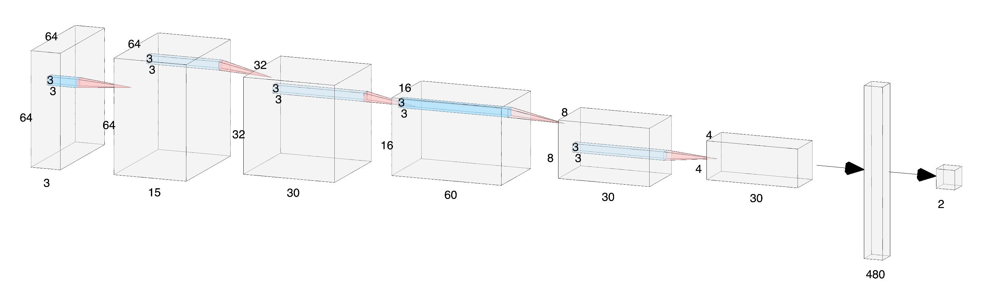
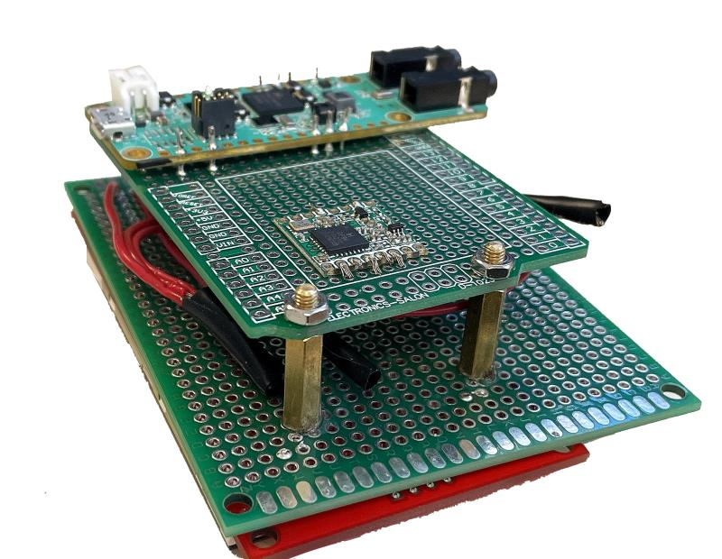
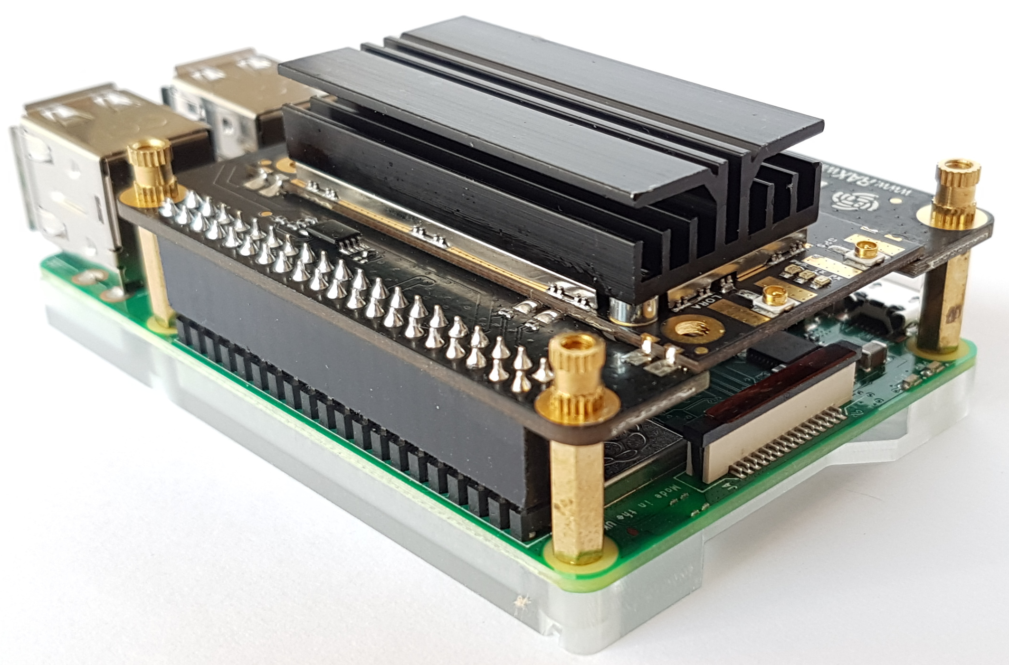
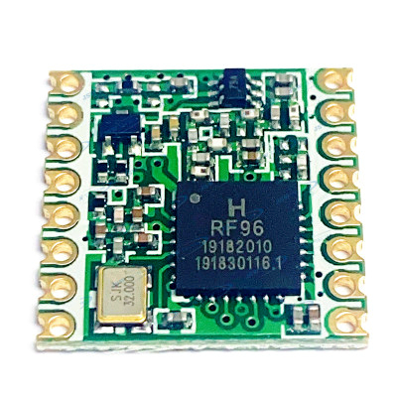
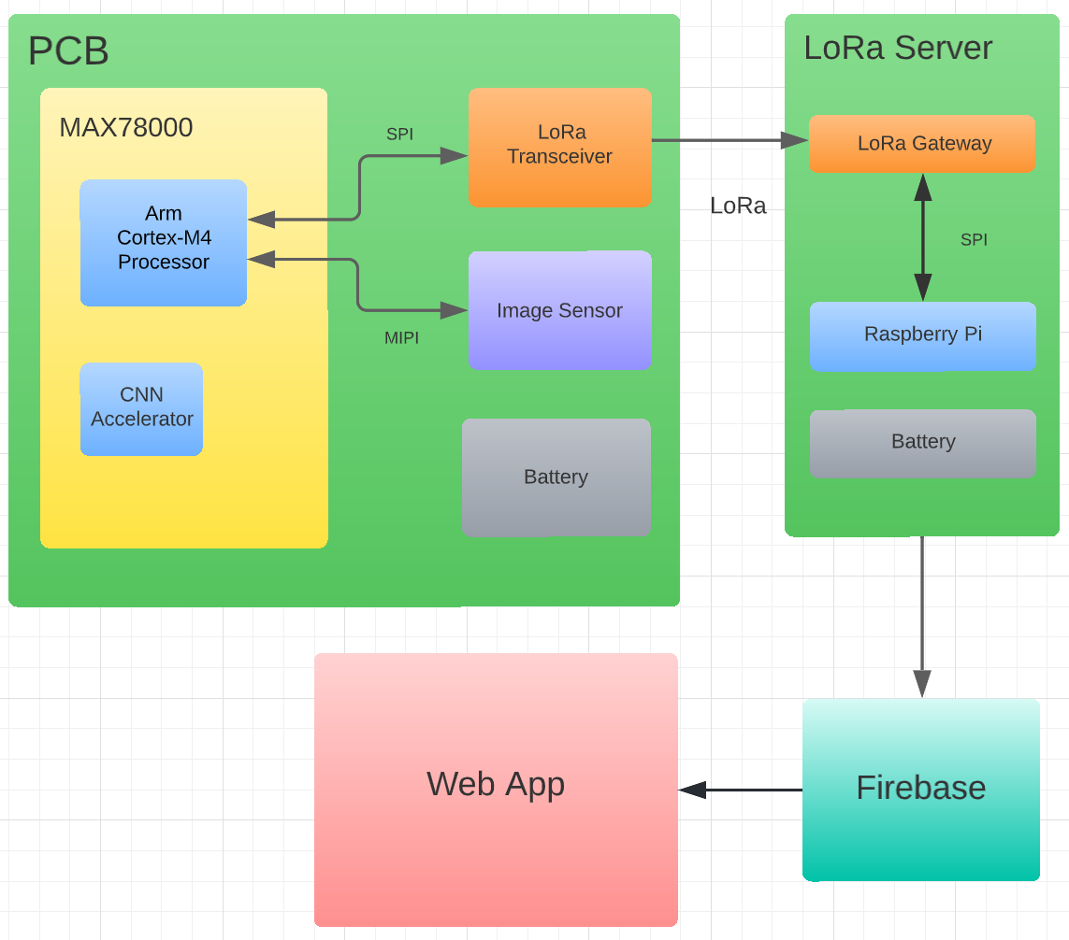
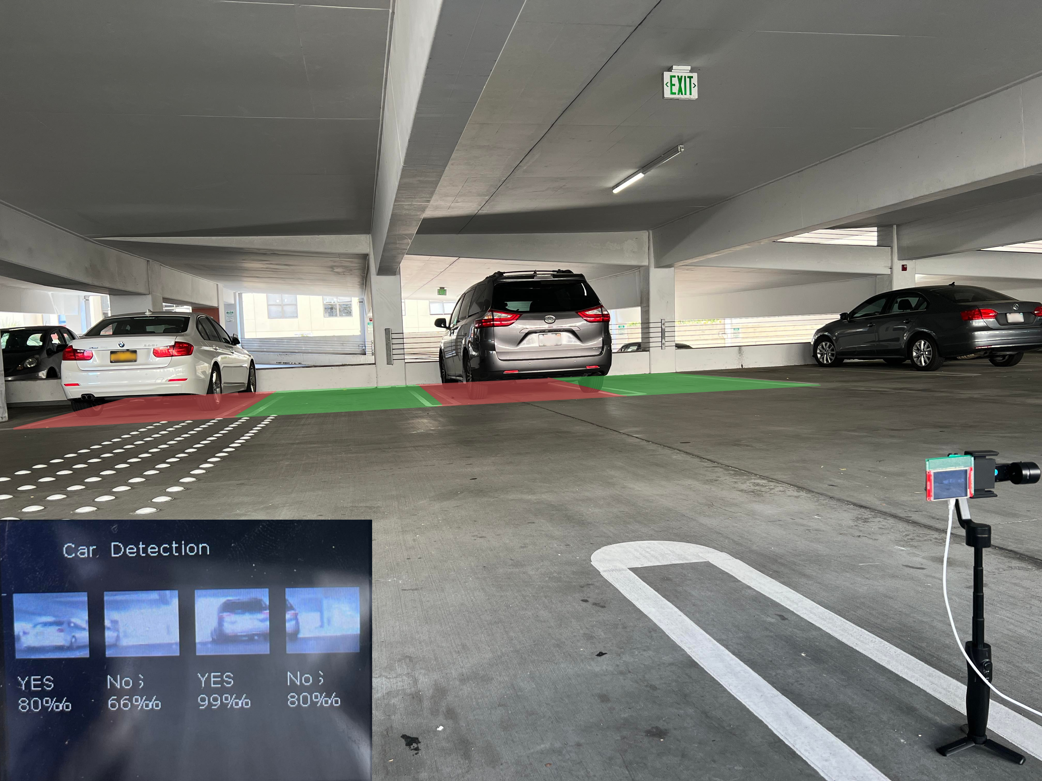
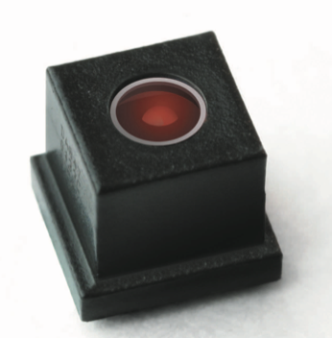
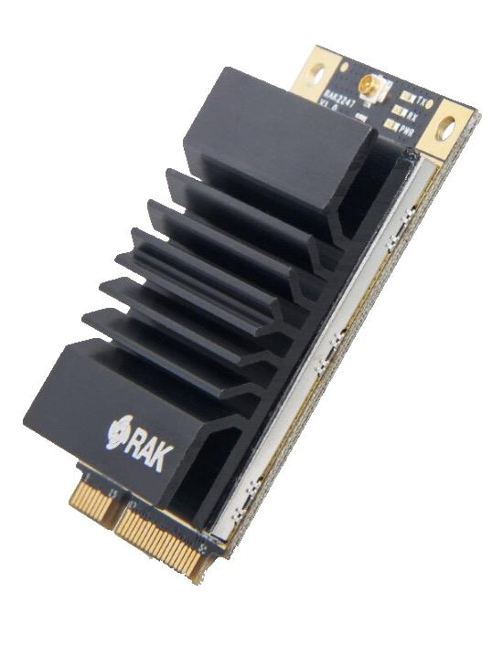
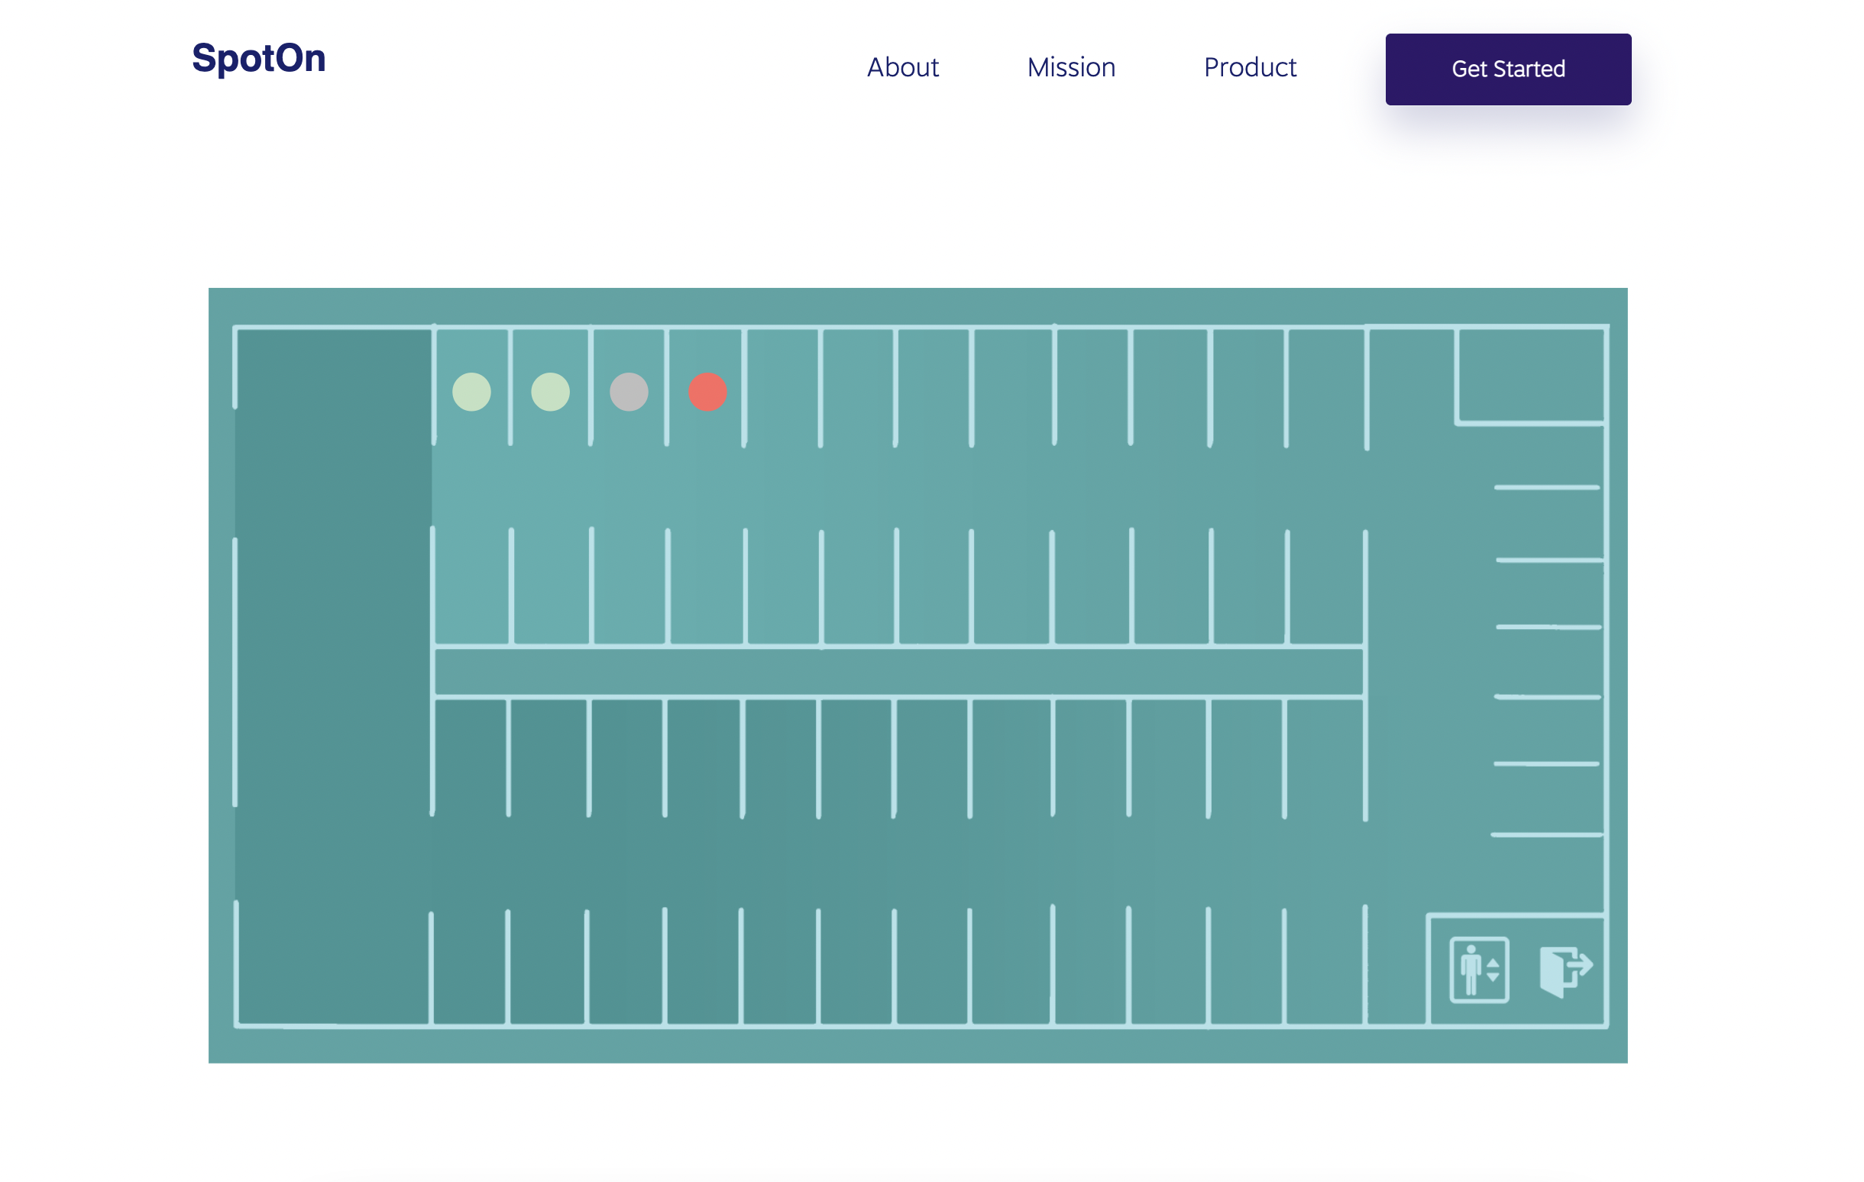
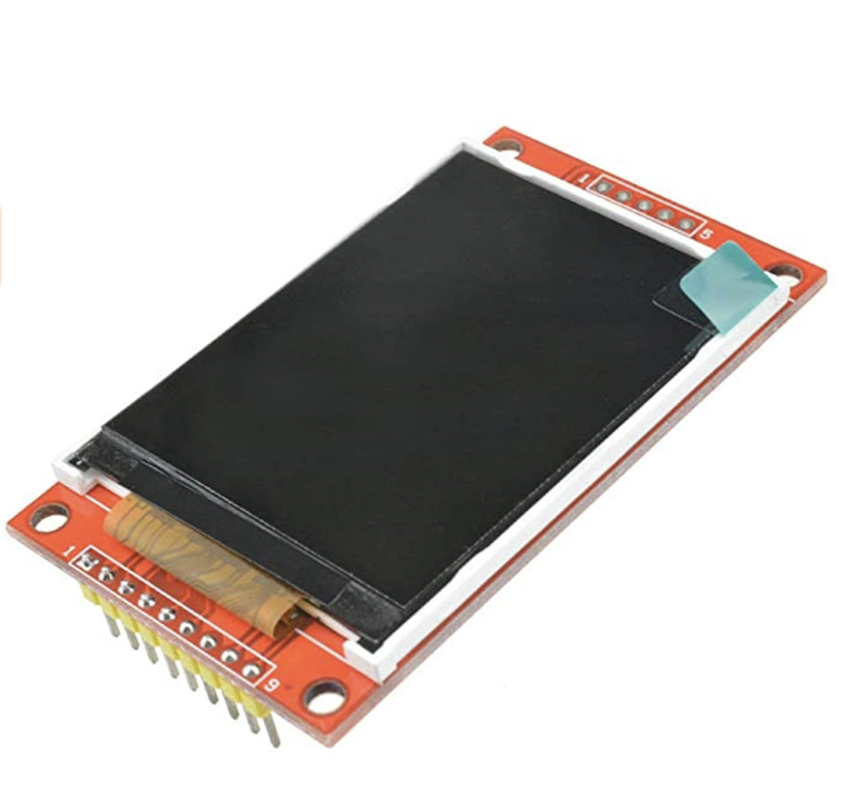

Smart Parking System
Haoming Chen | Kyle Wong | Ian Wu | Isaac-Neil Zanoria | Jiachen Zhang
Background
Final Design
CNN Model Architecture
Finding parking spots is an issue that plagues every driver. SpotOn addresses this problem by proposing an intelligent parking sensor system powered by machine learning. Using an on-board CNN accelerator, parking spot detection can be accomplished with low cost and low power consumption. Spot statuses are sent to a central database using LoRa wireless communication and rendered on a web application for users to easily access.
Vehicle Detection Node
Gateway
Server
Design Specs
Periodically capture images of parking spaces using an OVM7692 image sensor
Segment and feed captured images to a CNN model capable of detecting vehicles
Send parking availability to central server using LoRaWAN communications
Display parking availability on a react web application for users
Describe key result (consider bullet point list).
Caption and/or text (preferably bullet points)
Hardware / Key Components
MAX78000
Arm® Cortex®-M4
CNN Accelerator
Supports 3.5 million 8-bits weights
RFM95W Transceivers
LoRaTM Modem
168 dB maximum link budget
SPI Interface
Field Test
Block Diagram
OVM7692
1/13-inch optical format
Automatic Exposure/Gain Control
MIPI Interface
RAK2247 LoRaWan Gateway
-139dBM sensitivity
Full LoRaWAN 1.0.2 stack support
SPl interface
Describe key result (consider bullet point list).
ILI9341TFT LCD Display
Resolution: 240x320
SPI Interface
Acknowledgements:
Special Thanks to Yogananda Isukapalli, Brycen Westgarth, Christopher Cheney

Slide 2


